Slide 1




MindSage: An AI-powered Mental State Assessment Chatbot for USC Students
Presentation by Team 3
Amanda Ferrell
Pallavi Thalakola
Hasithasunayana Ganta
Manasa Devi Chinta

Slide 2


Background
By nearly every metric, student mental health is worsening. Nearly 29% of students reported having poor mental health, and over 42% of students said they felt depressed or gloomy all the time. Remarkably, one in ten students attempted suicide and more than one in five considered it.
These alarming statistics from the CDC in 2021 highlight the importance of our proposal. By providing all-encompassing support and tackling the stigma attached to mental health,

Slide 3
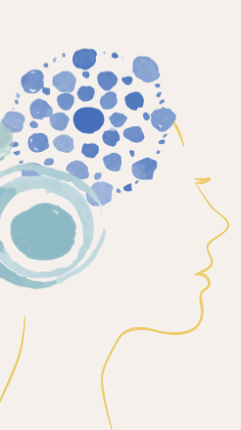
The MindSage Solution
The "MindSage" project at the University of South Carolina aims to address declining student mental health by deploying an AI-driven chatbot to foster a stigma-free environment, leveraging data collection, machine learning, and NLP for mental health assessment, classification, and appointment scheduling with mental health professionals, while prioritizing collaboration with experts and stringent data security measures.

Slide 4
Objectives
1
2
Conducting comprehensive data collection through well-designed surveys and questionnaires to understand the specific mental health needs of the student population.
3
Utilizing advanced AI techniques such as machine learning and NLP to analyse student data and identify patterns related to mental health issues.
4
5
Implementation of a user-friendly AI-powered chatbot system to assess the mental health of USC students.
Categorization of students based on their mental health needs and the urgency of support required.
Scheduling timely appointments with mental health professionals for students in need of counselling or assistance.

Slide 5
Outcome:
The ultimate unique outcome of the "MindSage" project encompasses a transformative paradigm that goes beyond providing support. It envisions an ecosystem where mental well-being is seamlessly integrated into the student experience.
It goes further by offering an innovative approach, utilizing a chatbot to schedule appointments, fill critical gaps in mental health services, and assess students' well-being through a simple questionnaire.
The unique aspect is the incorporation of Artificial Intelligence (AI) to make informed decisions on whether a student requires psychological counseling and, if so, determining the optimal duration for that counseling.
In this envisioned future, the project doesn't merely reduce statistics of students contemplating or attempting suicide; it endeavors to make such occurrences exceedingly rare.

Slide 6

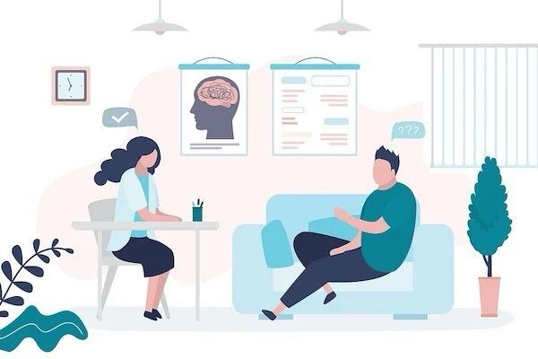
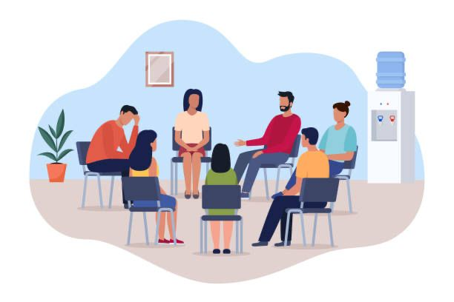
Current State:
Systematic and student-centric approach designed to address the diverse and often complex mental health needs of the student population.
Conducted through a combination of questionnaires, interviews, and self-reporting mechanisms.
Initial assessment, scheduling appointments.
Counseling sessions unfold - be it individual or group therapy
Post session reviews and feedback from students.

Slide 7


Current State:
Challenges:
Heavy dependence on human resources for administrative tasks.
The time-consuming nature of traditional methods, poses challenges for students and professionals alike.
Limited insight into the full complexity of students' mental well-being.
Traditional methods may not provide immediate assistance, impacting the overall efficacy of mental health support.

Slide 8

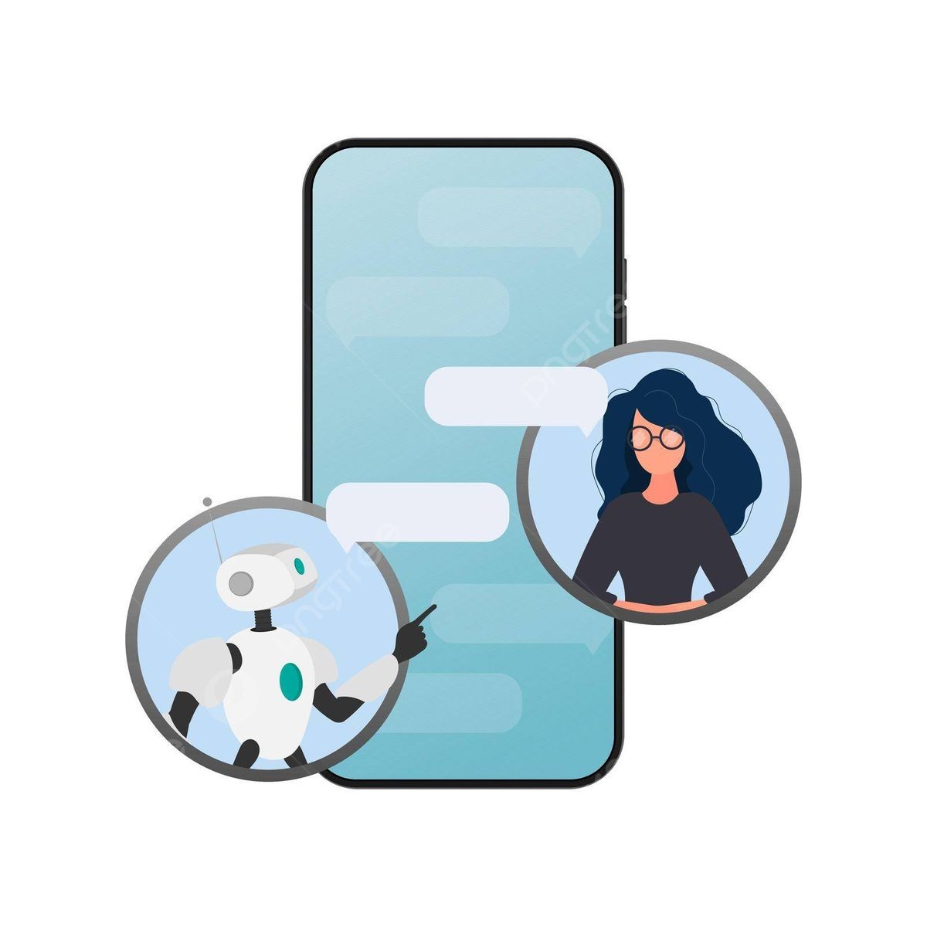
Future State:
AI-powered chatbots serve as the first point of contact.
Uses sophisticated algorithms and natural language processing to gather vital information and assess the urgency of mental health concerns.
With real-time data on counselor availability and student requirements, the chatbot recommends appropriate time slots, ensuring quick access to mental health support.

Slide 9
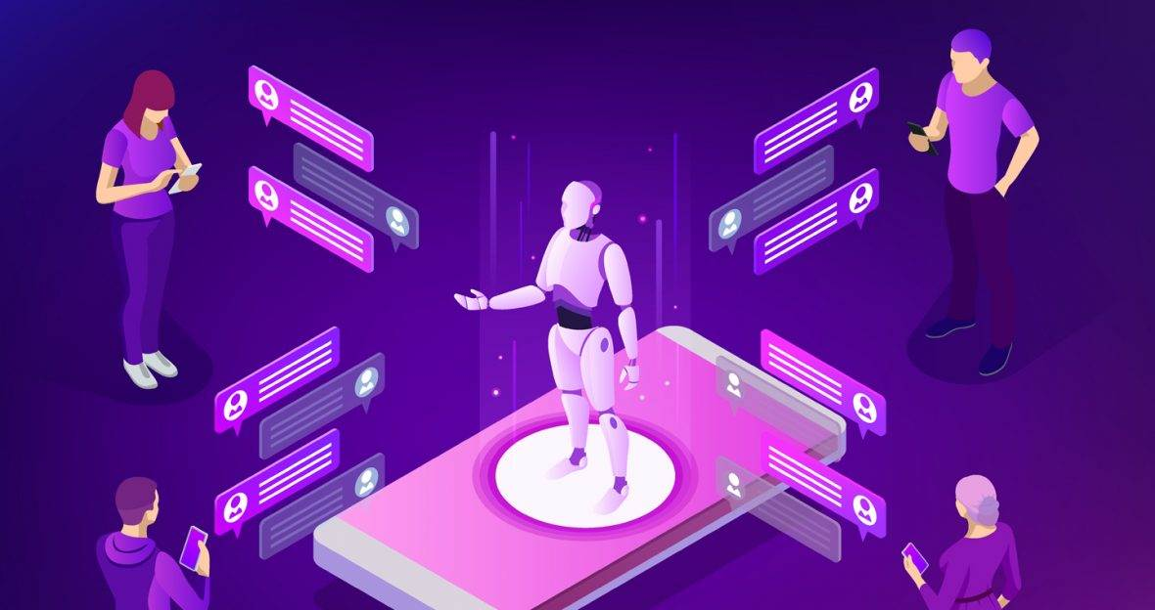
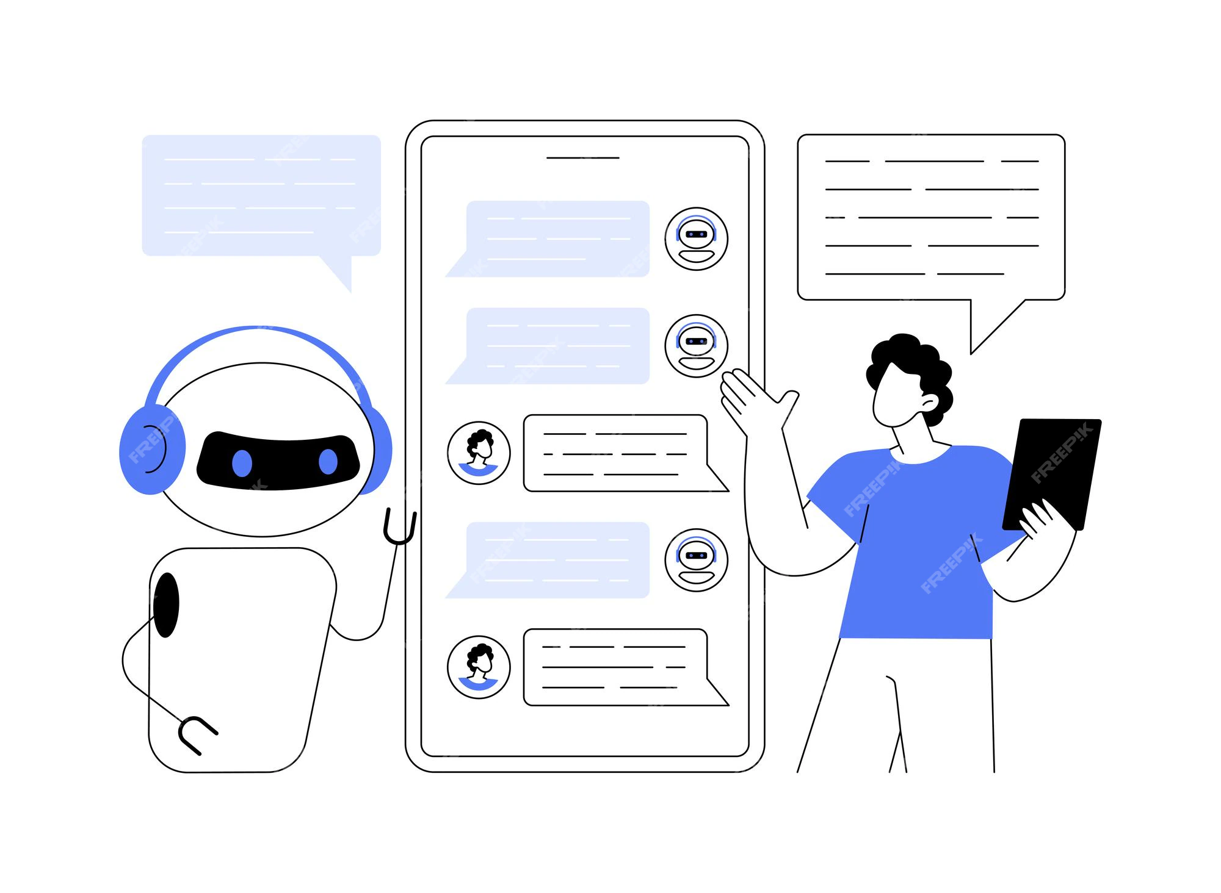
Advantages:
AI-powered chatbots enhance accessibility by providing students with 24/7 mental health support.
AI chatbots facilitate continuous monitoring of students' mental well-being by engaging in regular check-ins.
AI streamlines mental health workflows by automating routine administrative tasks, reducing the burden on human counselors.
Chatbots can learn and improve over time through user feedback.
Continuous monitoring for early detection and data-driven insights inform campus-wide mental health strategies.

